Slide 1
Understanding Non-Fungible Tokens Through Social Media Discussion
By: Dave Poretsky
Honors Thesis Presentation
Faculty Advisor: Dr. Suhong Li
Editorial Reviewer: Dr. Tingting Zhao

Slide 2
Agenda
Significance and Overview
Literature Review
Research Questions/Objectives
Methodology
Data Analysis
Conclusion
Limitations & Future Research

Slide 3
Significance
New Evolving Tech
Accessibility
Value
Recently popularized and it’s always changing for new applications
Anybody with extra $ and Internet
Financial gain is infinite

Slide 4
Overview
Blockchain
Crypto
Twitter
Non-Fungible Tokens (NFTs)
This study aims to gain a deeper understanding of the non-fungible token community and industry through an in-depth analysis through social media discussion via Twitter.

Slide 5

Literature Review

Slide 6
Literature Review
Blockchain
Overview of Blockchain
Functionality of Blockchain
Crypto
Functionality of Cryptocurrency
Popularity of Cryptocurrency
Twitter
Overview of Twitter
Impact of Twitter
NFTs
Overview of NFTs and the Industry

Slide 7
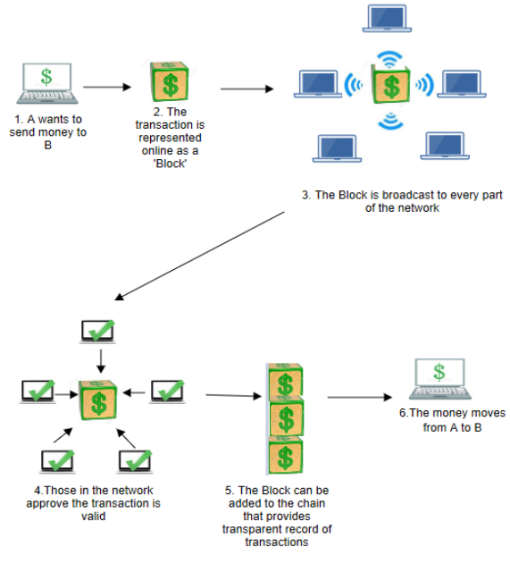
Literature Review: Blockchain
Building block of both crypto and NFTs (Ante, 2021)
Not owned by any company, government or organization (Sarmah et al., 2018)
Distributed over internet
Blockchain simplified:
Encrypted transaction data creates a block
A link of previous transactions creates the chain (Sarmah et al., 2018)
Figure source: (Sarmah, 2018)
Notes:
The architecture of blockchain is distributed, meaning that it does not have a central point over the internet. Instead, there are several nodes and connections which are the foundation of the cryptocurrencies which are all using the blockchain technology

Slide 8
Literature Review: Cryptocurrency
Overview:
Crypto is “electronic cash” which uses blockchain technology (Farell, 2015)
NO intrinsic value, simply supply and demand (Limba, 2019)
Bitcoin is pioneer in blockchain technology created in 2009
Mining crypto is people authenticating the transactions within the network
Their efforts are rewarded in new coins (Farell, 2015)
Popularity:
Marketcap is $1.9 trillion with 17,957 different coins in circulation (CoinMarketCap.com)
Bitcoin and Ethereum make up 61.4% of market cap
Marketcap has grown over 1050% in the past 4 years (Abraham, 2018)

Slide 9
Literature Review: Twitter
Overview:
Launched in 2006
One of largest social media platforms with 1.3 billion account by 2018 (Abraham, 2018)
Average of 500 million tweets per a day (1 out of 15 people on Earth)
83% of world leaders have Twitter accounts
(Abraham, 2018) & (Vilas, 2020)
How it relates:
Elon Musk has 132 million followers
He changed his account bio to “#bitcoin”
The crypto increased from 32k to 38k in hours
Market cap of coin increased by $111 billion
(Ante, 2022)

Slide 10
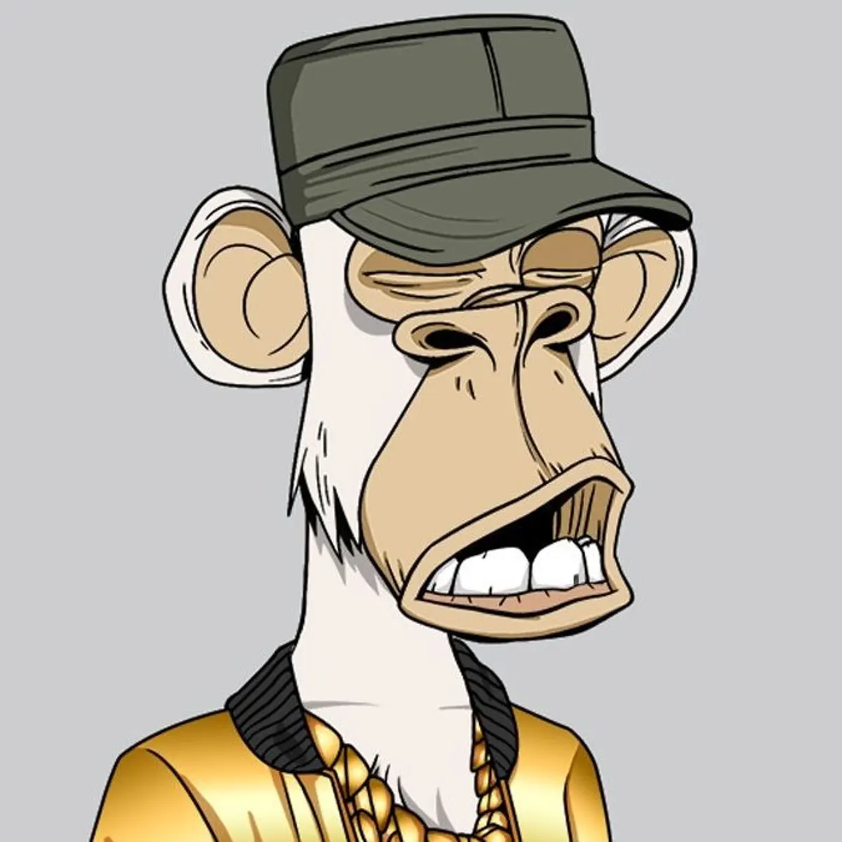
Literature Review: NFT’s
Overview:
Created in the mid 2010’s
Essentially a form of non-fungible crypto
Pictures, GIFs, music, collectibles, video game items
(Wang, 2021) & (Nadini et al., 2021)
Value:
Based on supply and demand of the specific artwork
24H NFT market average trading volume is $4.5 Trillion
Dorsey first tweet
(Kapoor et al., 2022) & (Ante, 2021)

Slide 11
Research Questions
What is the overall sentiment of tweets related to the users countries, age, and popularity of the accounts within the NFT community?
Who are the most influential Twitter users in the NFT market?
What are the popular topics being tweeted about, and are those topics popular NFT projects?

Slide 12
Methodology

Slide 13
Methodology: Data Analysis Process
4
Visualizations
1
Data Extraction
2
Data Cleaning
3
Data Modelling

Slide 14


Methodology: Data Extraction
Twitter Developer API
MongoDB
6.64 Million Tweets were extracted which mention the keywords: “NFT”, “NFTs”, “Bored Ape Yacht Club”, “CryptoPunks”, “The Sandbox”, “Art Blocks”, “Doodles”, “Cool Cats”, “CyberKongz”, “Decentraland”, “FLUF World”, “DeadFellaz”, “NFT Project”, “NFT Collection”, “Azuki”
All Tweets were collected during various hours of days throughout the Summer of 2022

Slide 15
Methodology
Data Cleaning/Analysis
Data was then cleaned to allow for proper analysis
Analyze content of the tweets
Sentiment, common hashtags, locations, age of accounts
Topic Modelling
All using DataBricks

Slide 16
Data Analysis

Slide 17
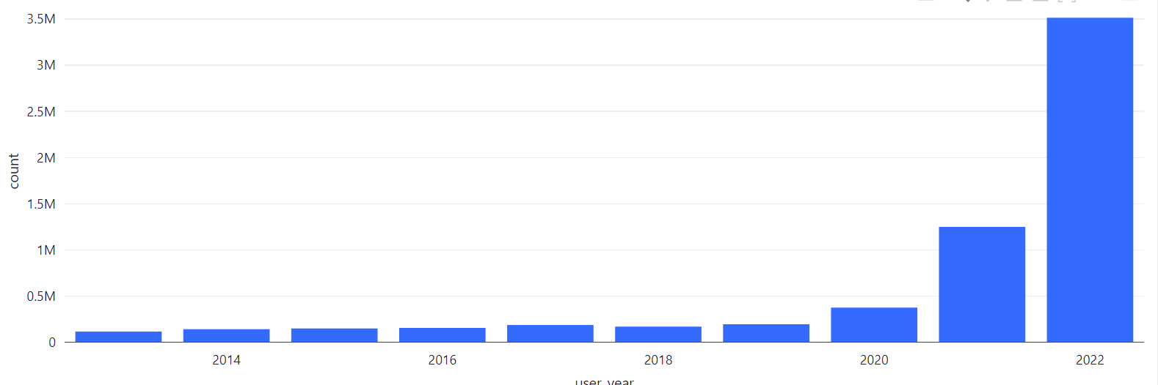
Data Analysis
Number of tweets by User, based on joined year
3.5 mil
+ 933%
375k

Slide 18
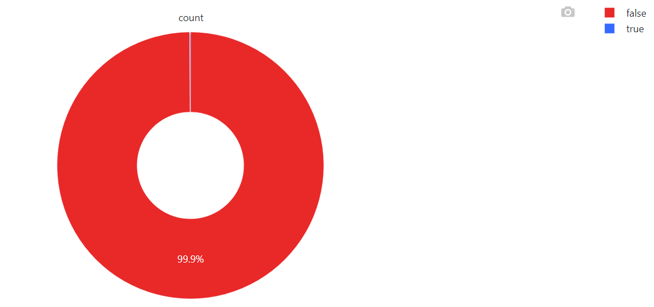
Data Analysis
Percent of Total Users Verified
“Previously, Twitter used a blue checkmark to indicate active, notable, and authentic accounts of public interest that Twitter had independently verified based on certain requirements”
6,624 (.10%) verified accounts

Slide 19
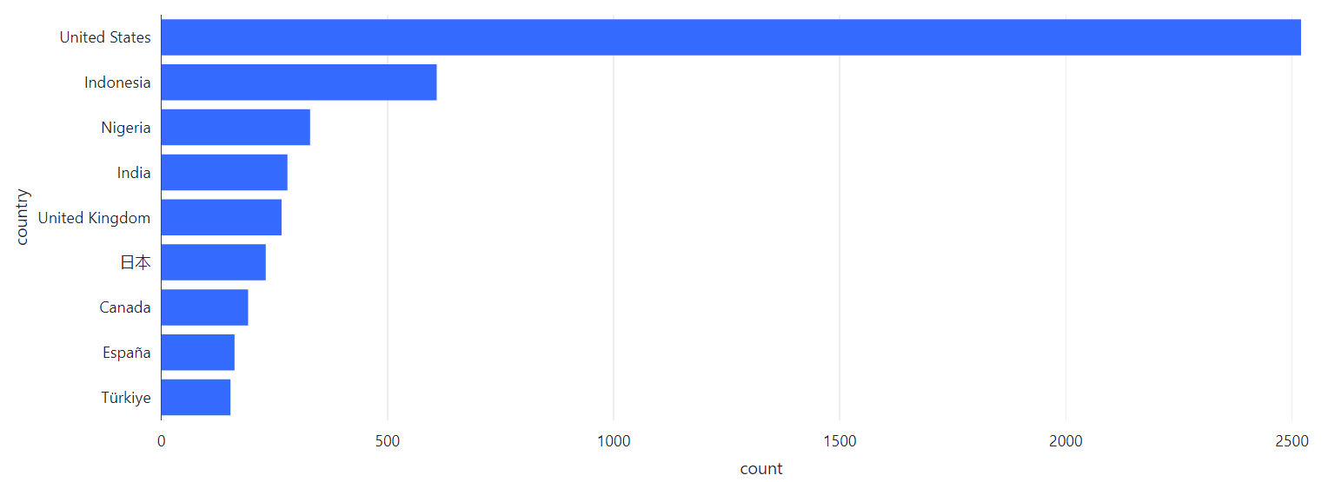
Data Analysis
Number of Countries by Twitter Users
About 99.93% were null (roughly 6.63 mil null)

Slide 20
Data Analysis
Sentiment Analysis Overview
Natural Language Processing (NLP) technique which labels data into 3 categories: positive, neutral and negative
Hugging Face is a popular NLP library
RoBERTa-base model for sentiment analysis from Hugging Face
Uses 124 million tweets to create a pre-trained model to be used to score sentiment

Slide 21
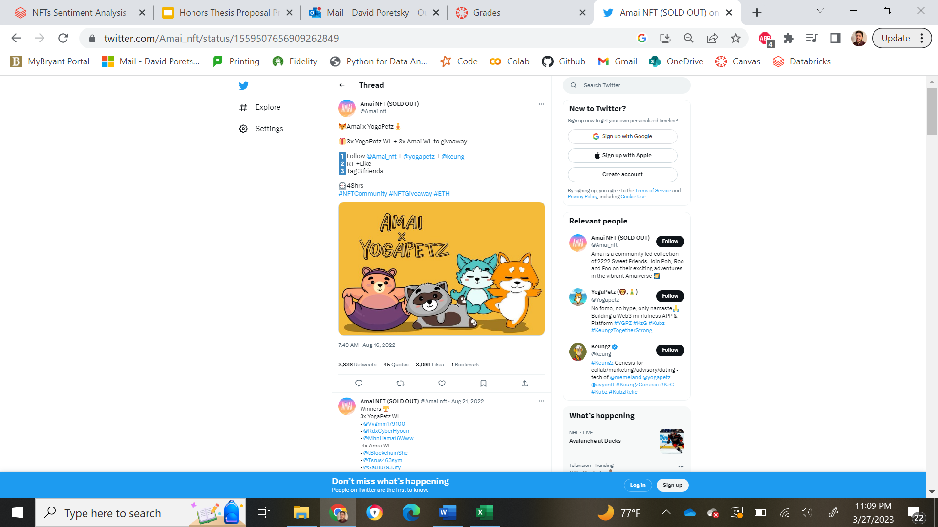
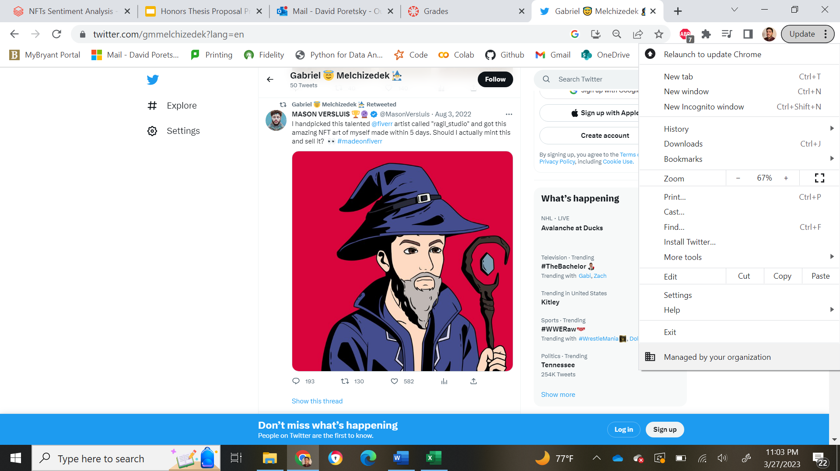
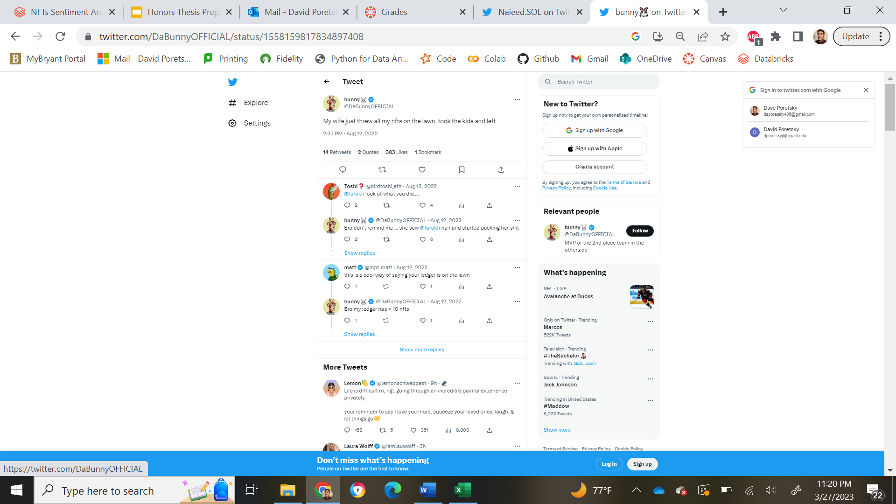
Data Analysis
Tweet Examples
Neutral
Positive
Negative

Slide 22
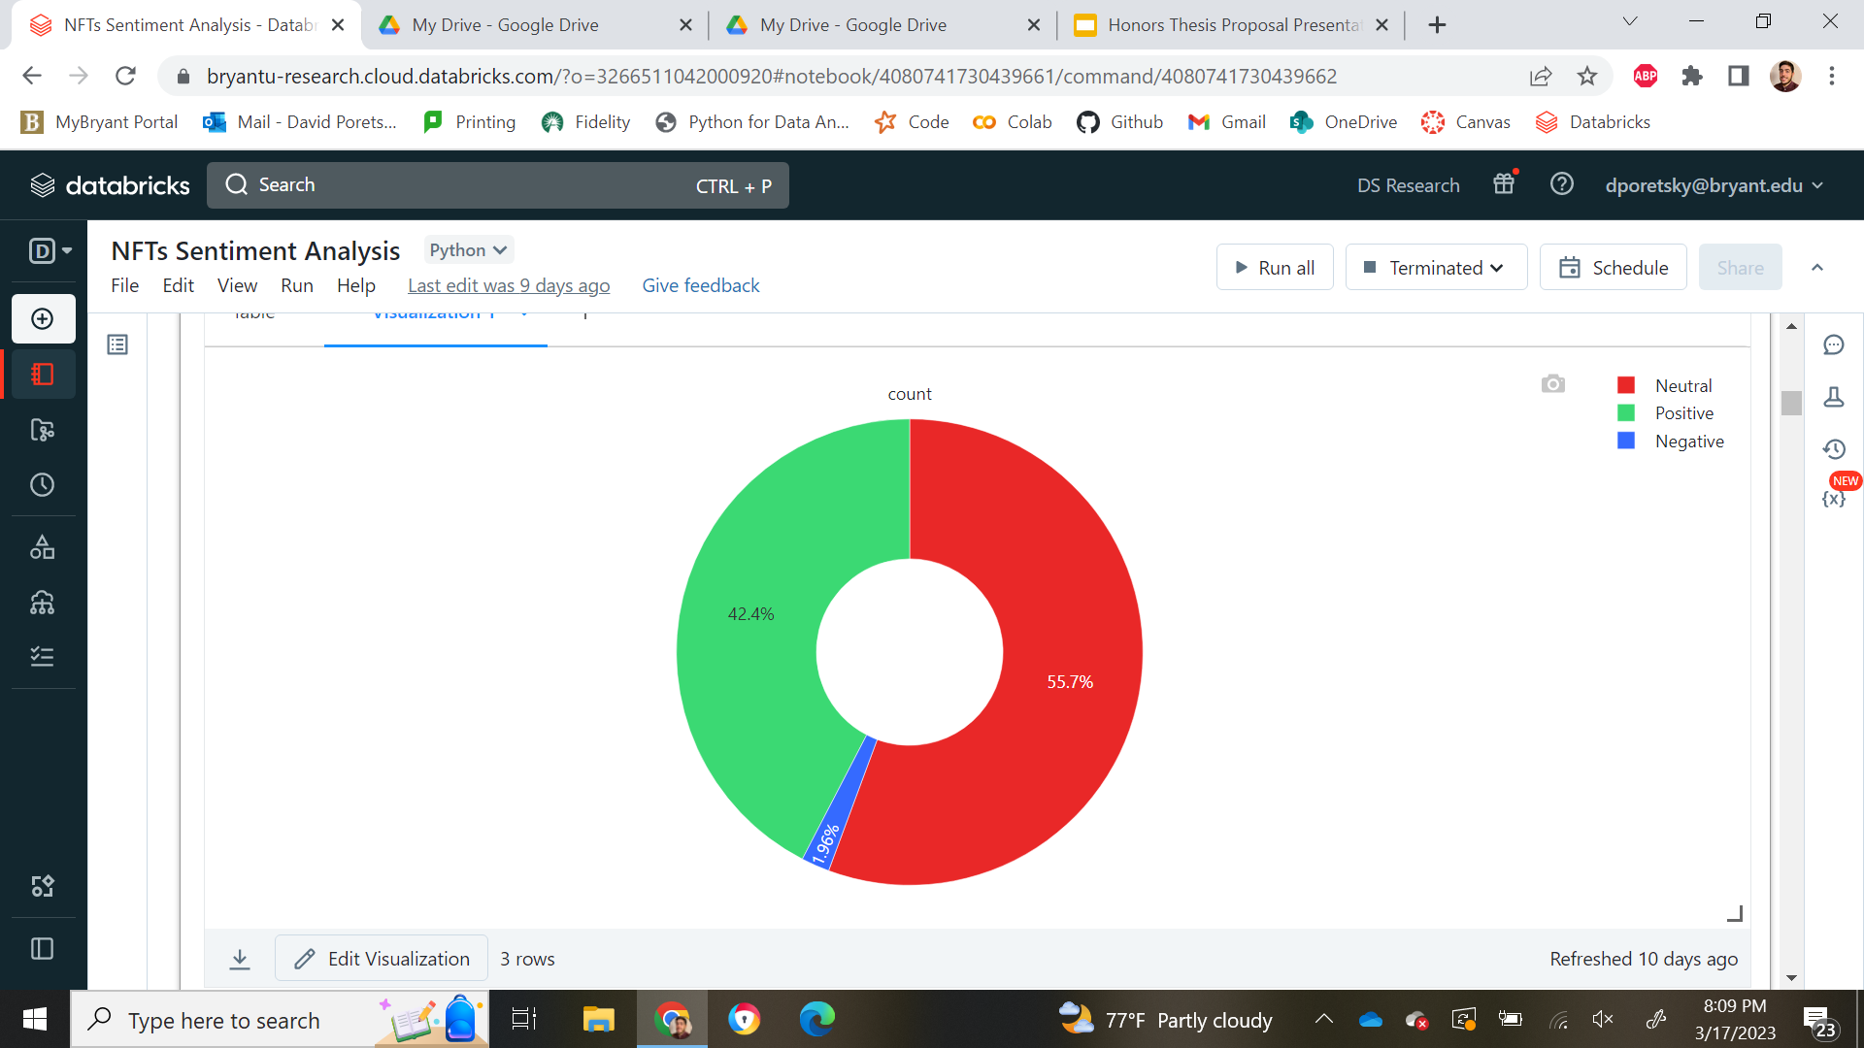
Data Analysis: Overall Sentiment
2.8 mil positive tweets
130k negative tweets

Slide 23
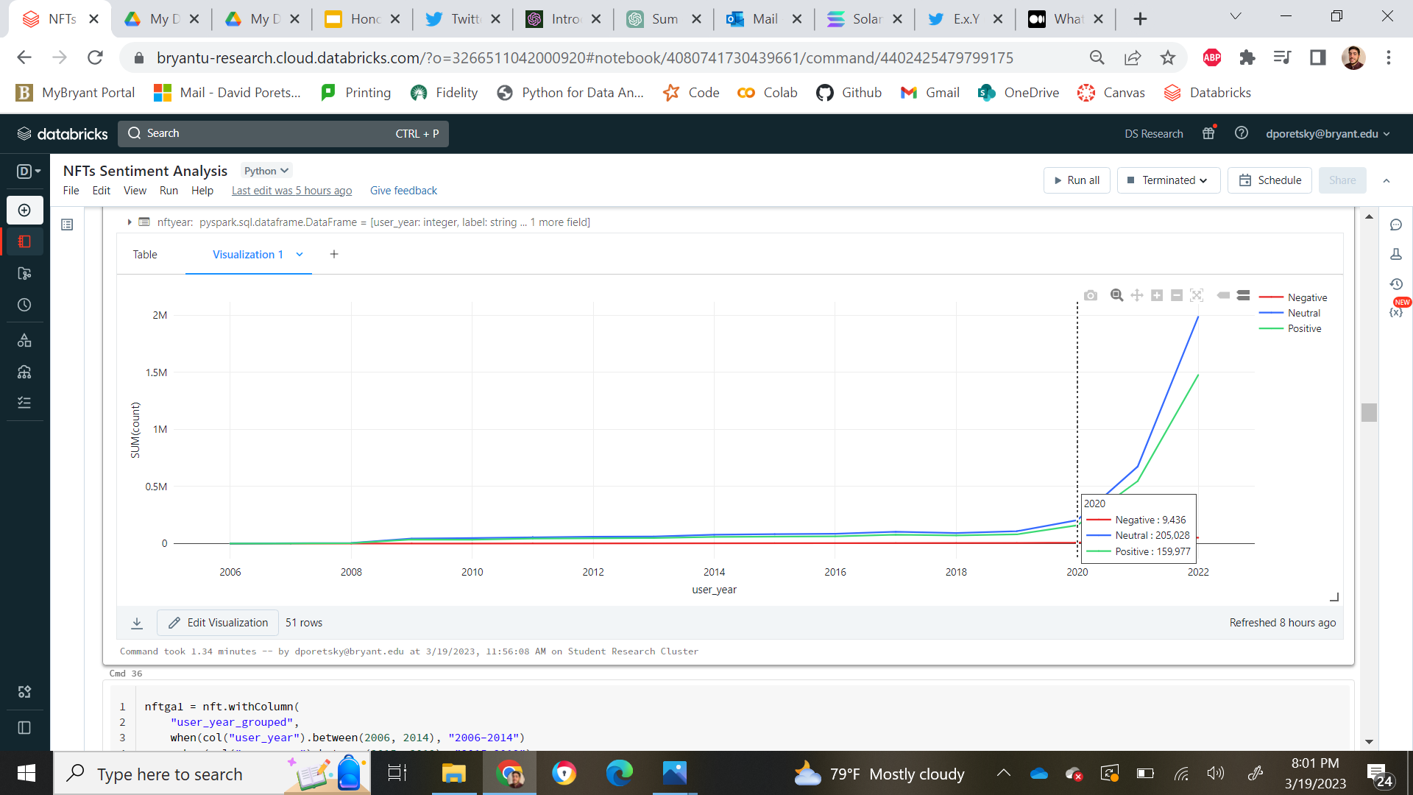

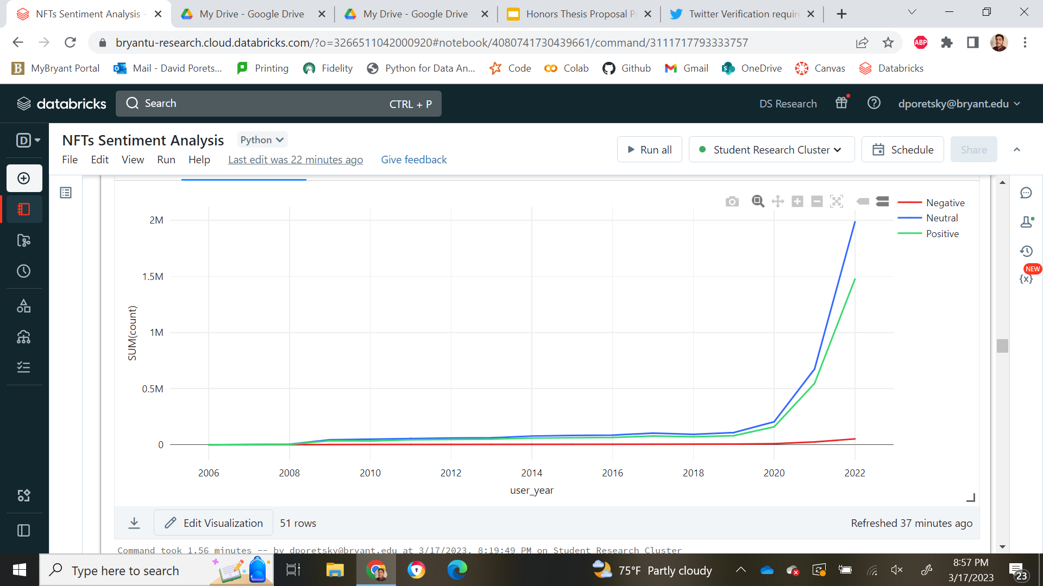
Data Analysis
Sentiment by Users, based on year
Positive had about a 930% increase
Neutral had roughly a 970% increase
Negative had roughly a 577% increase
Total user increase was roughly 933% from 2020 to 2022

Slide 24
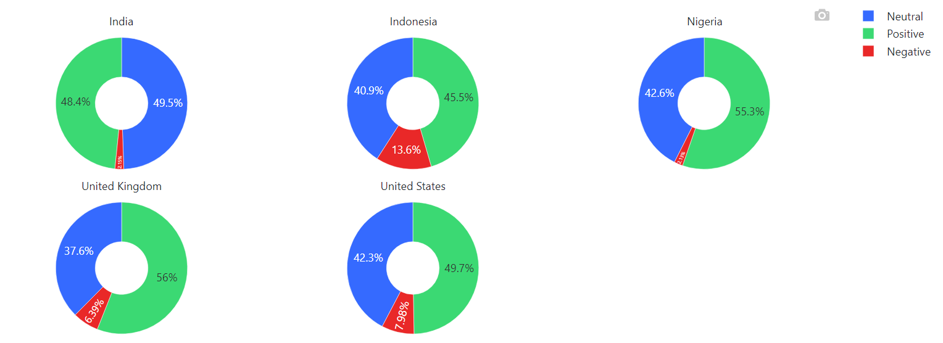
Data Analysis
Percent Sentiment by Users, based on Countries
Indonesia is the 2nd most country tweeted from
83 negative tweets total from Indonesia (less than USA’s 201)

Slide 25
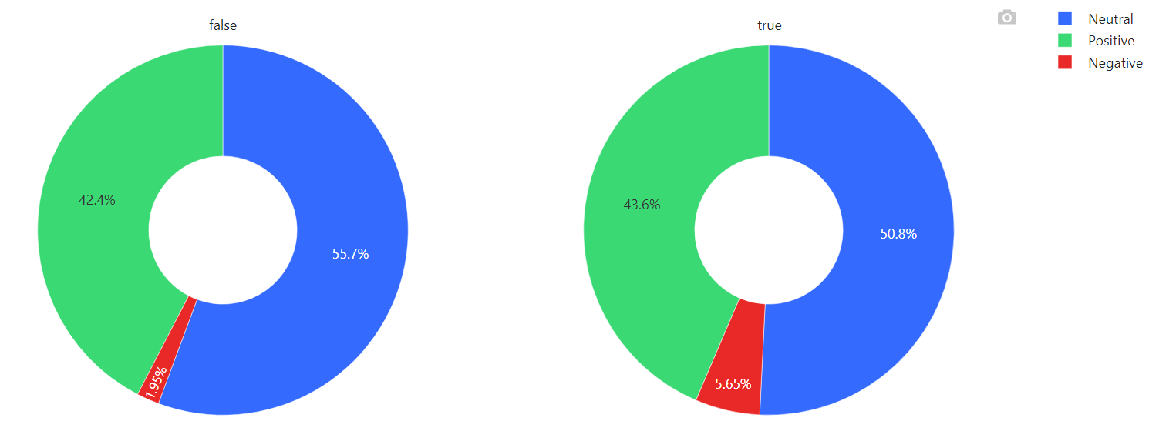
Data Analysis
Percent Sentiment by Users, based on verified accounts
Notes:
Only 374 tweets for ver acc

Slide 26
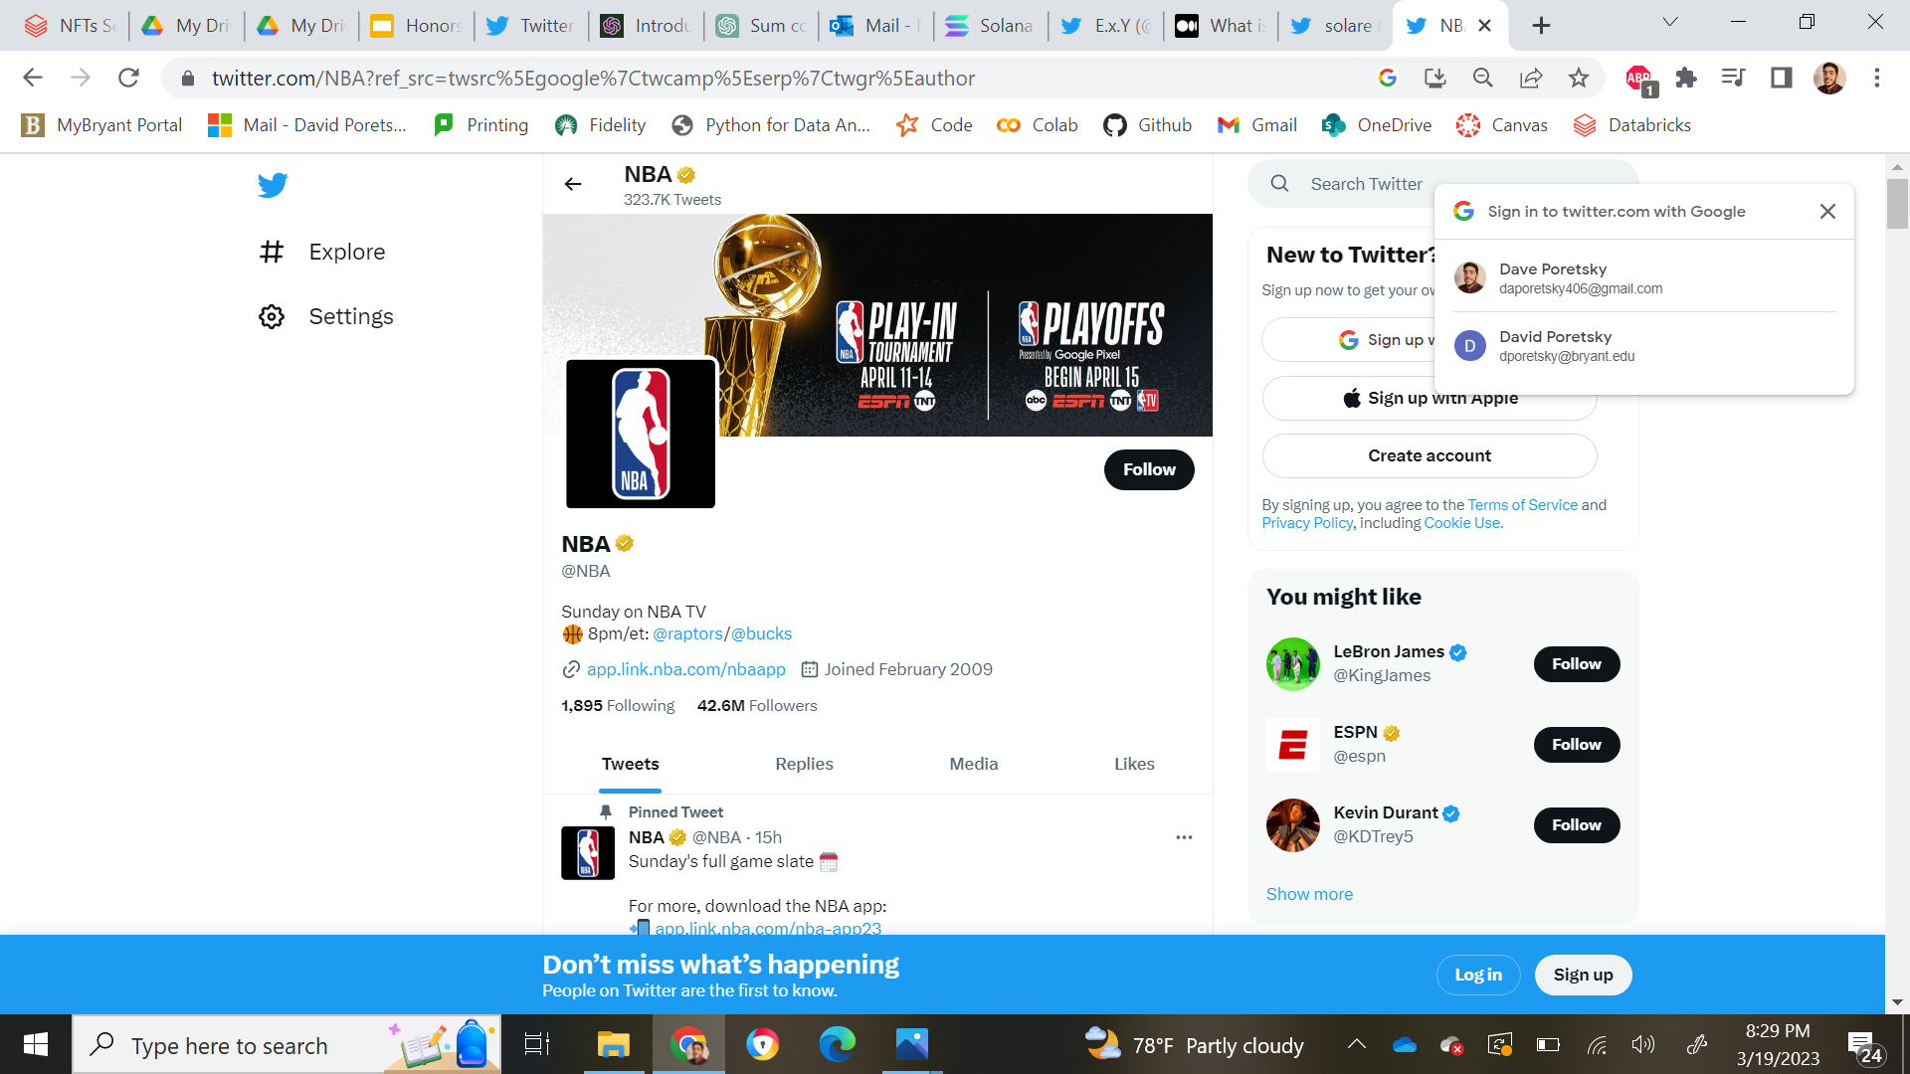
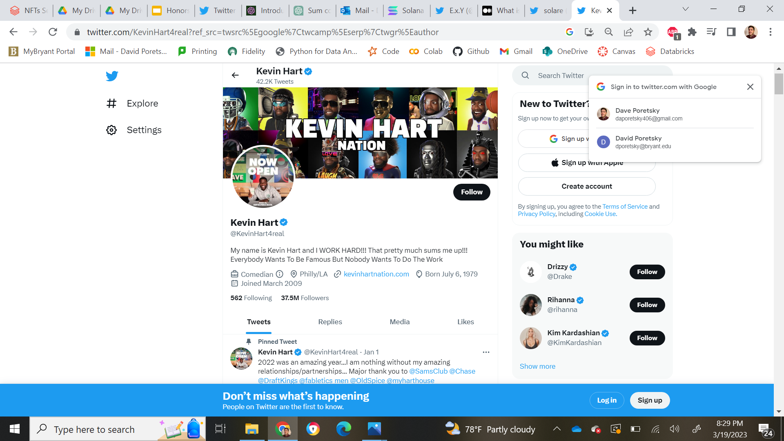
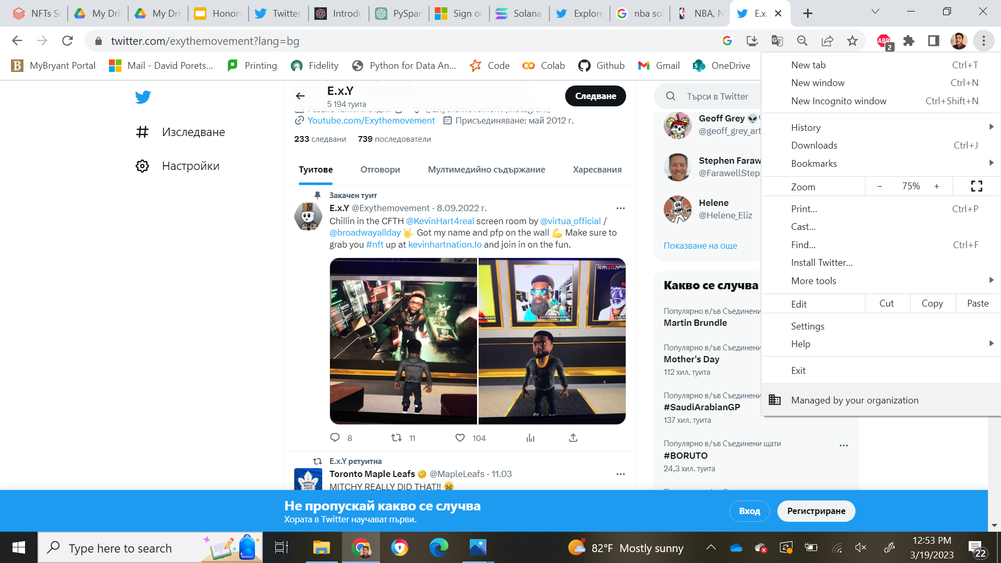
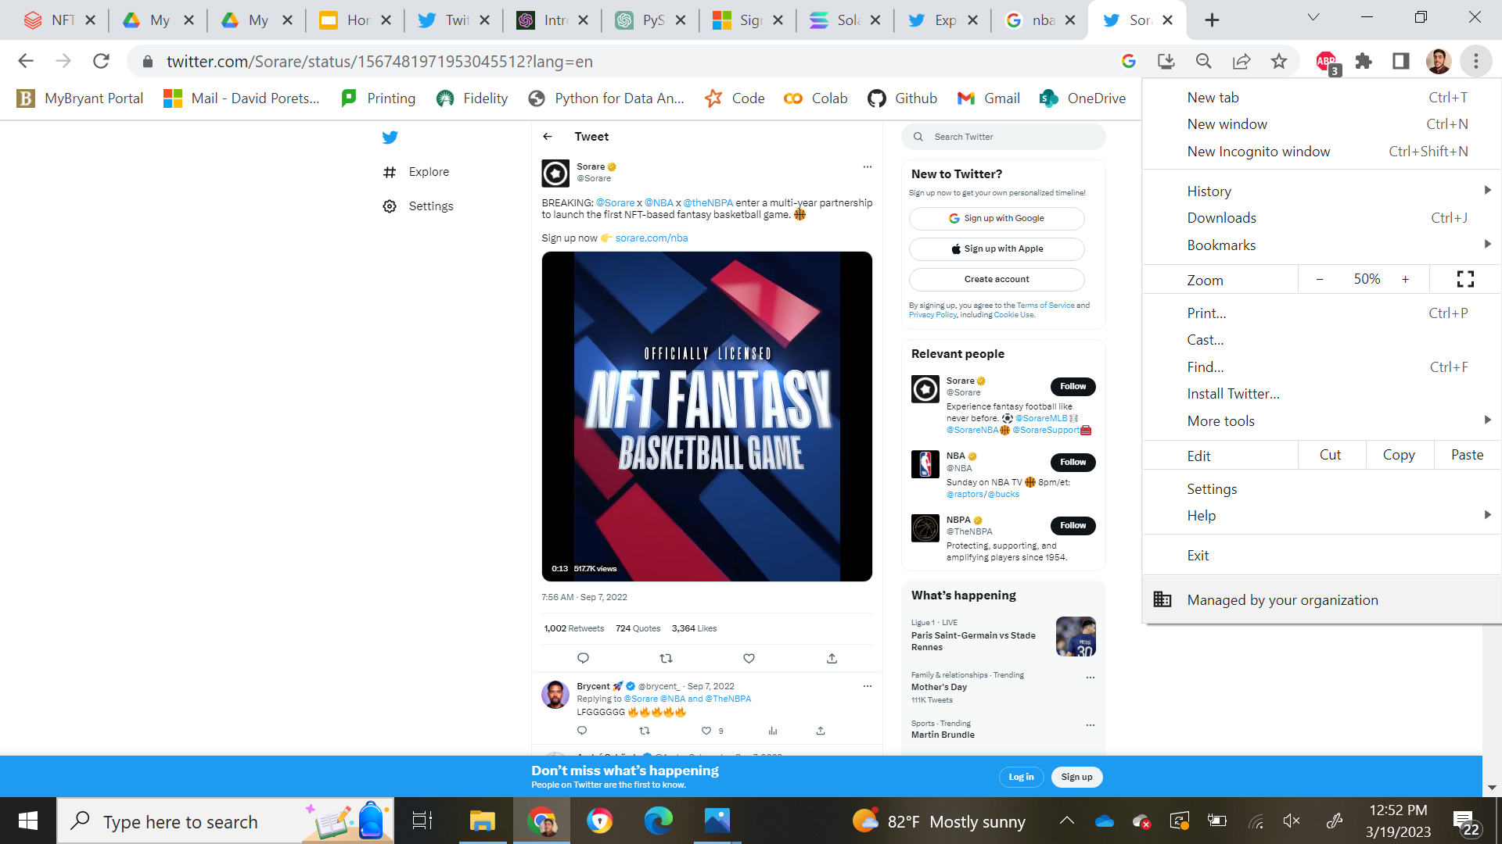
Most Influential Users

Slide 27
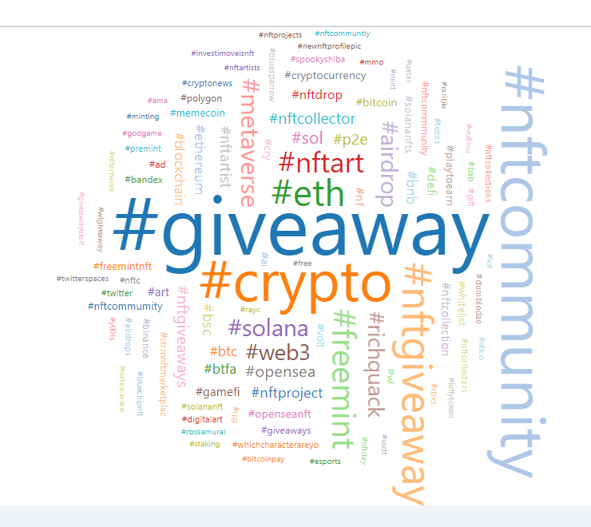
Data Analysis
WordCloud
Top 5 hashtags:
Giveaway, nftcommunity, crypto, nftgiveaway, eth
#giveaway appeared 190k times, which is 50k more than the 2nd most appeared word, nftcommunity
#giveaway appeared over double the amount of times as the #4 word, #nftgiveaway

Slide 28
Data Analysis: Topic Modelling Overview
A technique used in natural language processing and machine learning to identify topics or themes present in a collection of documents
LDA (Latent Dirichlet Allocation) is a machine learning algorithm used for topic modeling
The goal of LDA is to identify topics or themes present in a collection of documents

Slide 29
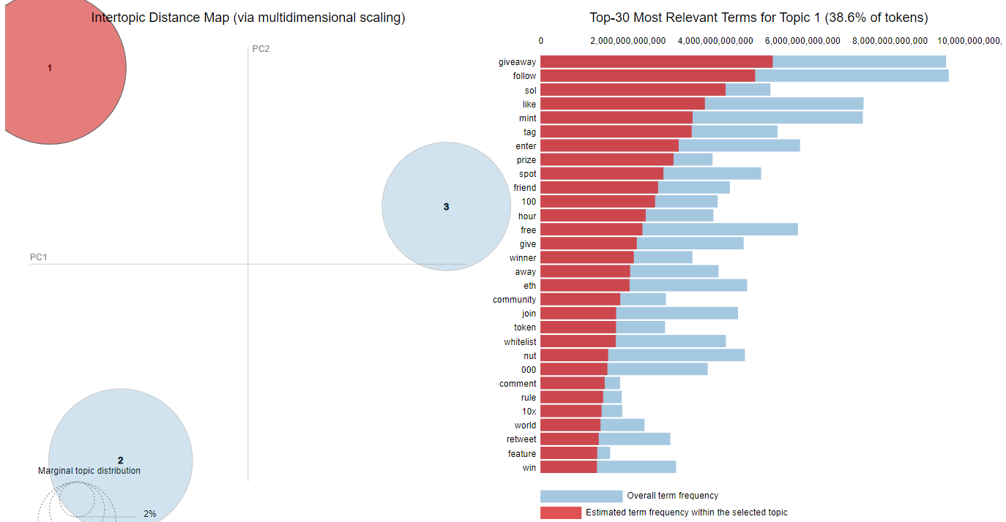
Topic modelling: Giveaways

Slide 30
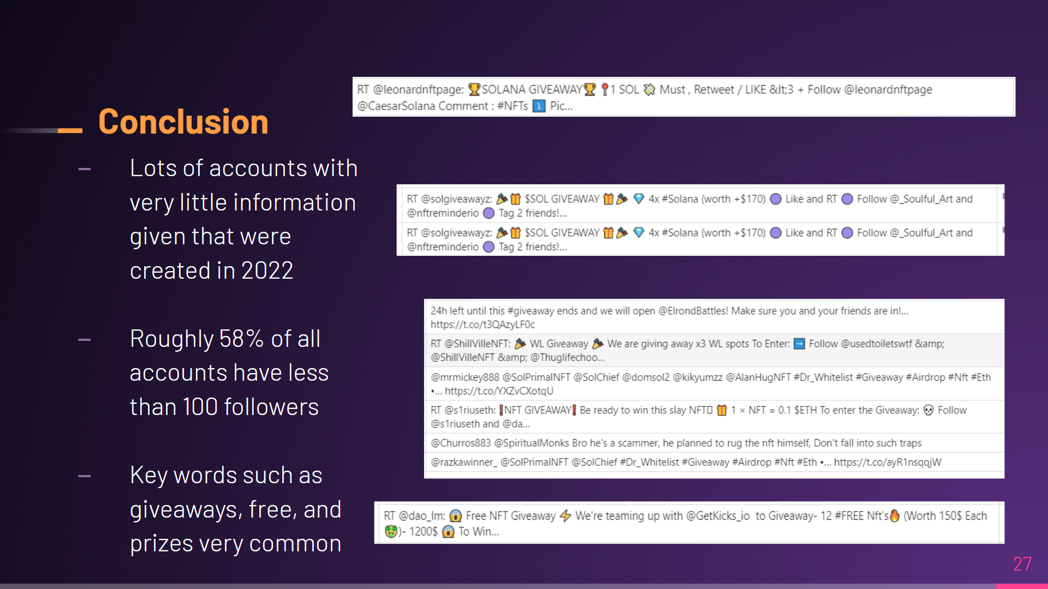

Slide 31
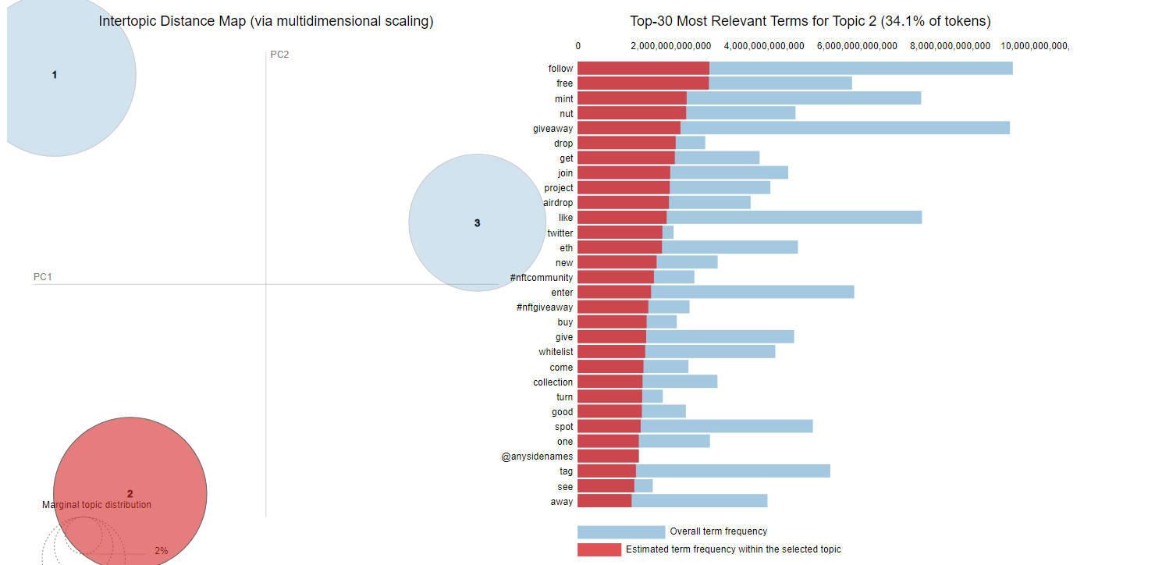
Topic modelling: Token Creation

Slide 32
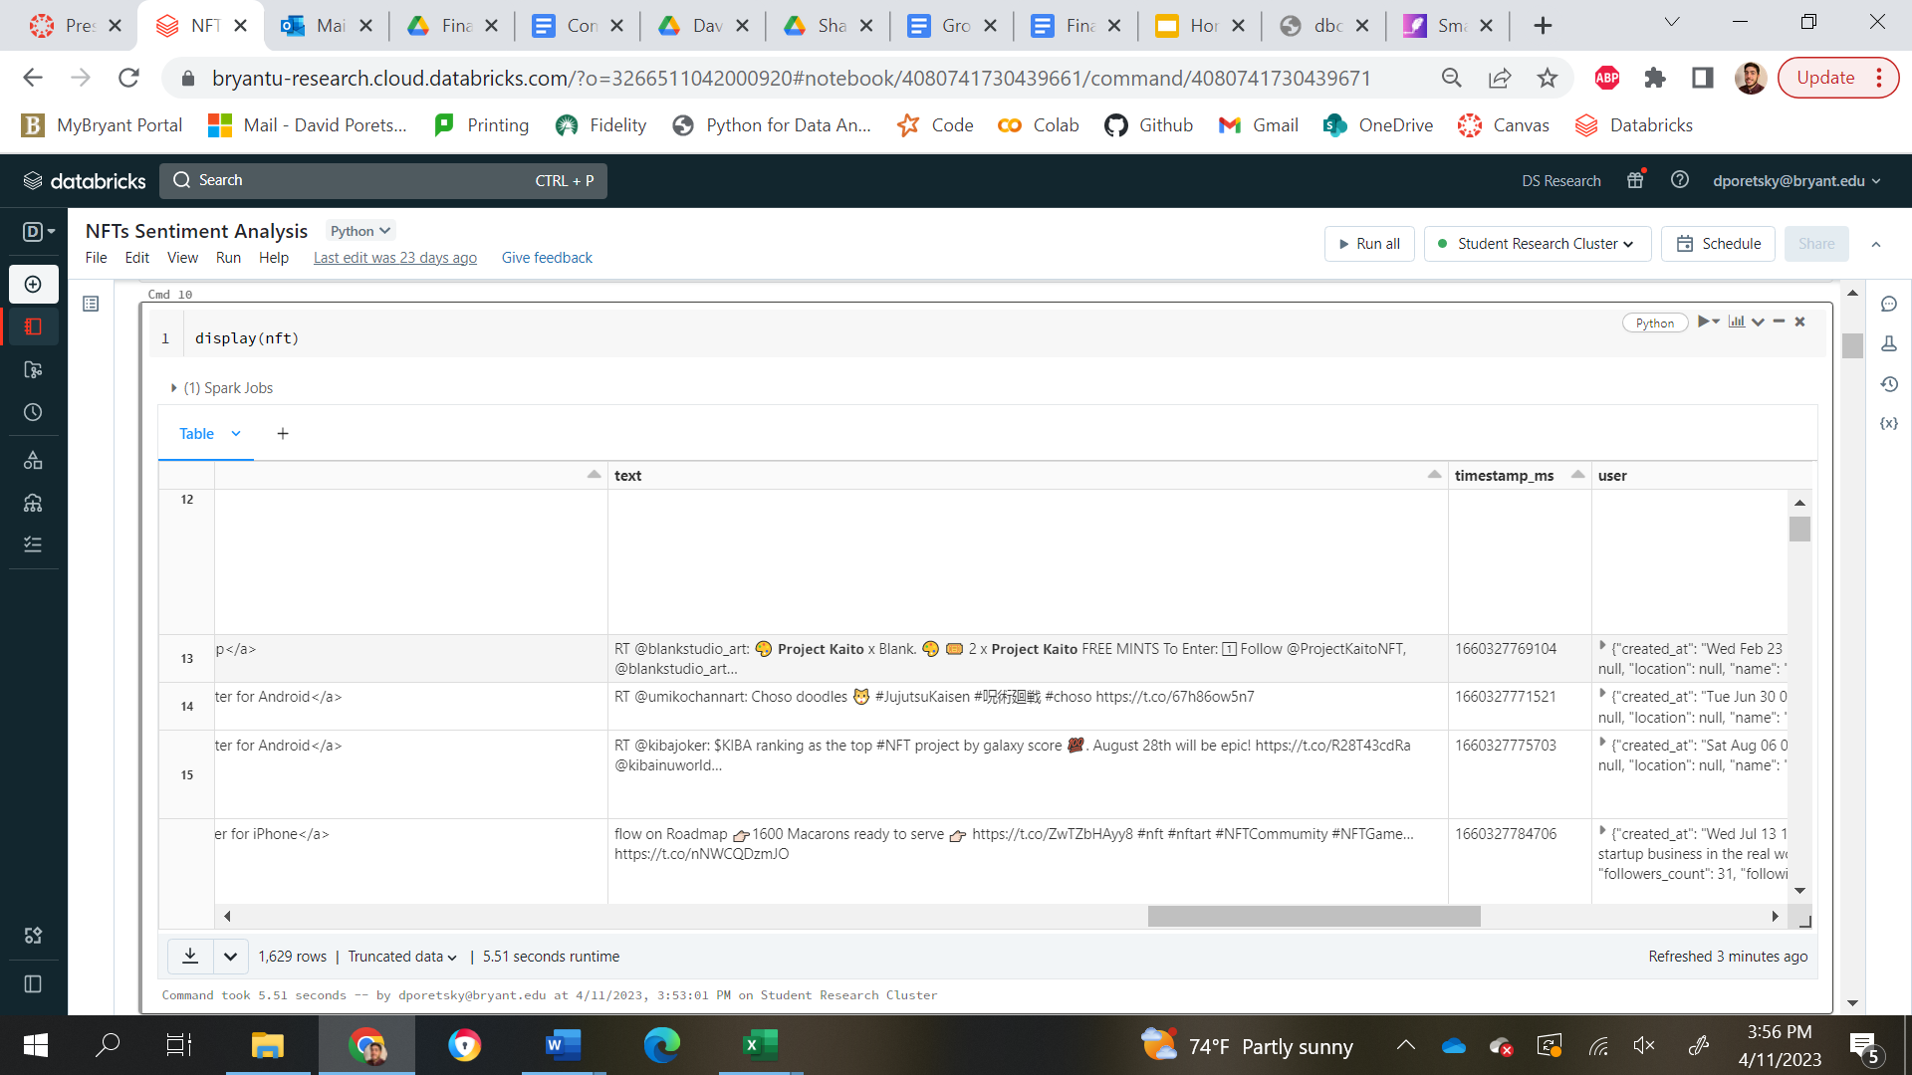
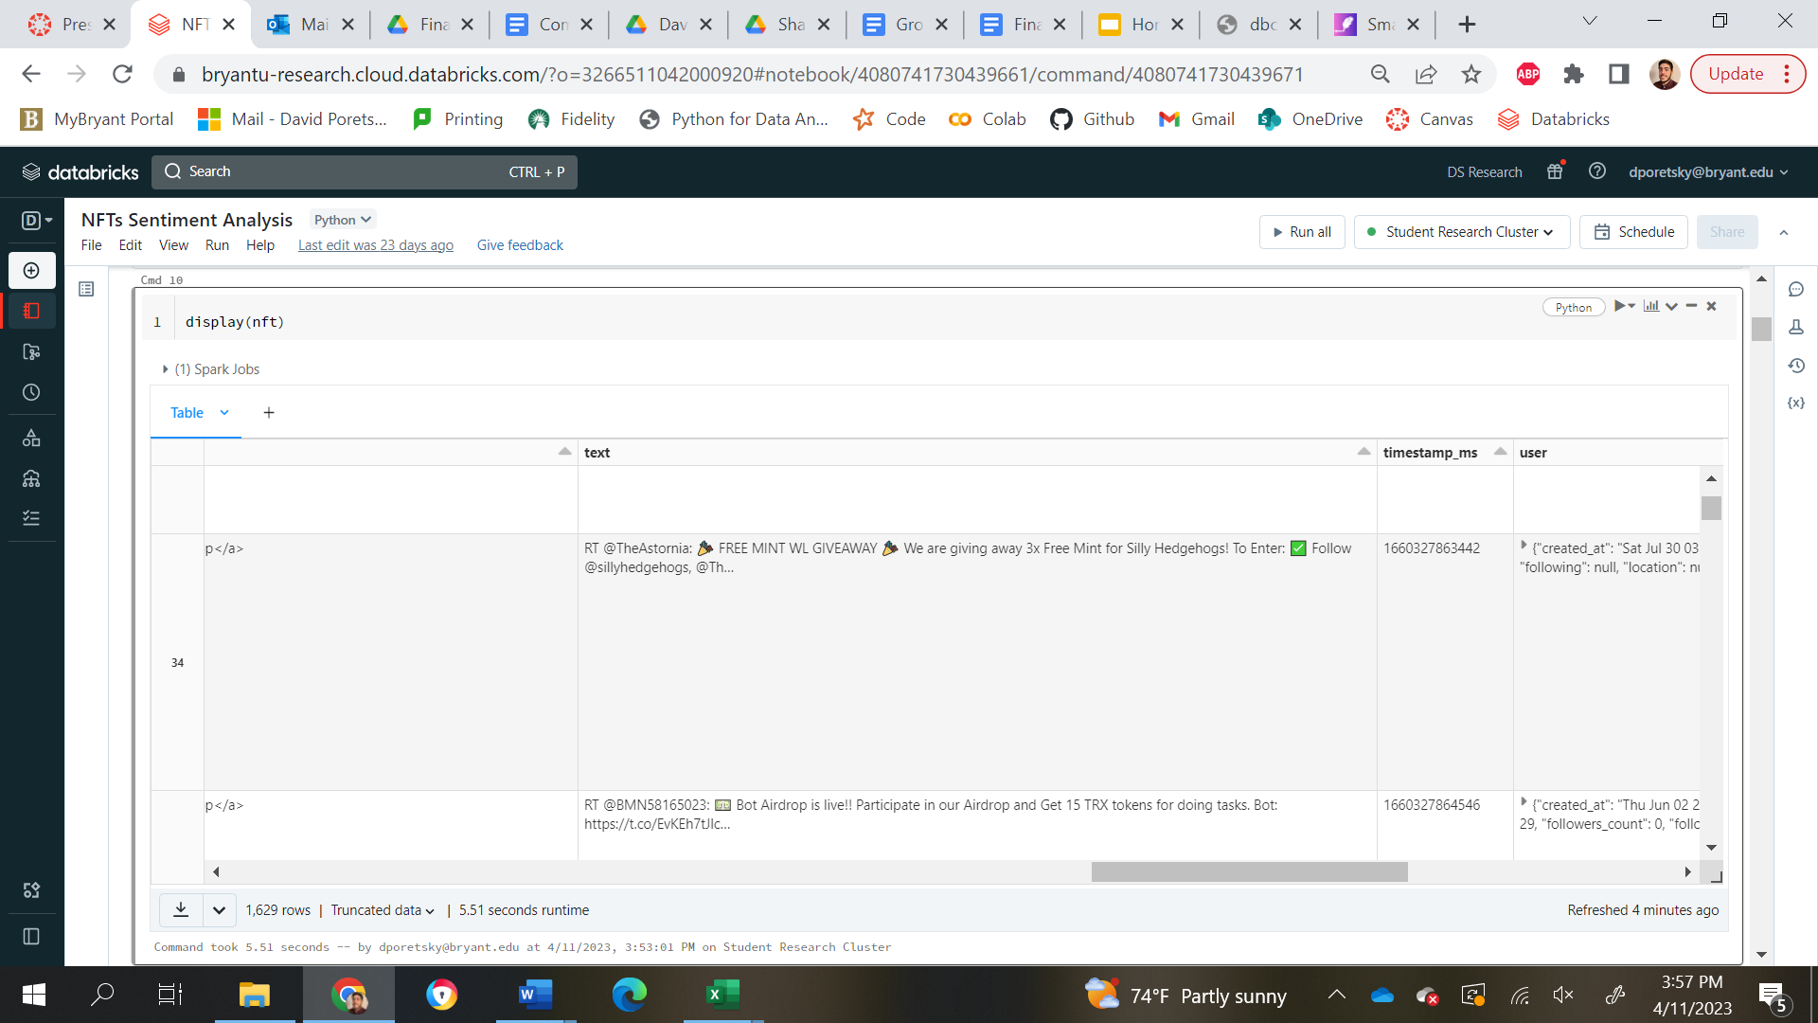
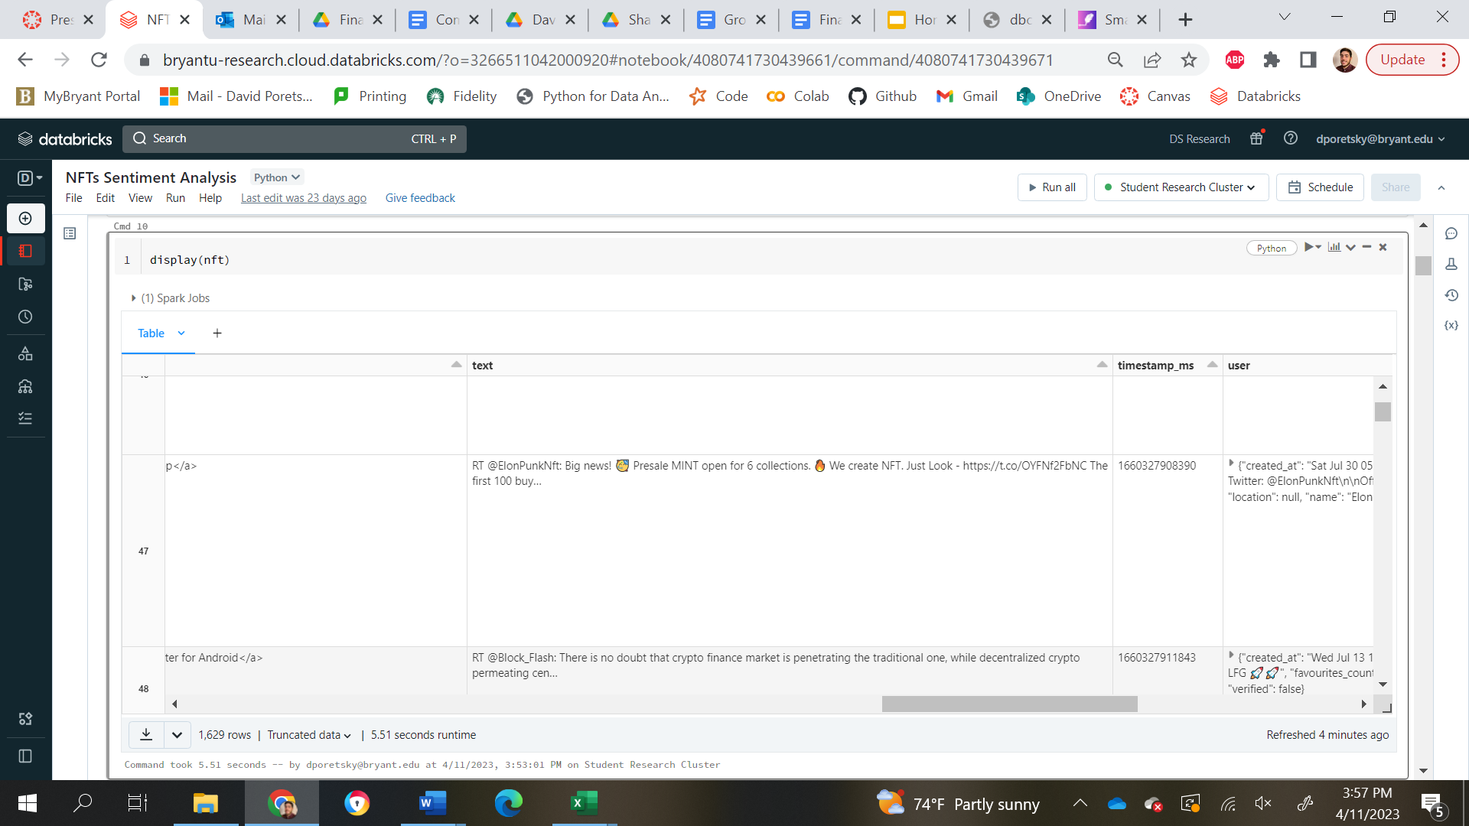

Slide 33
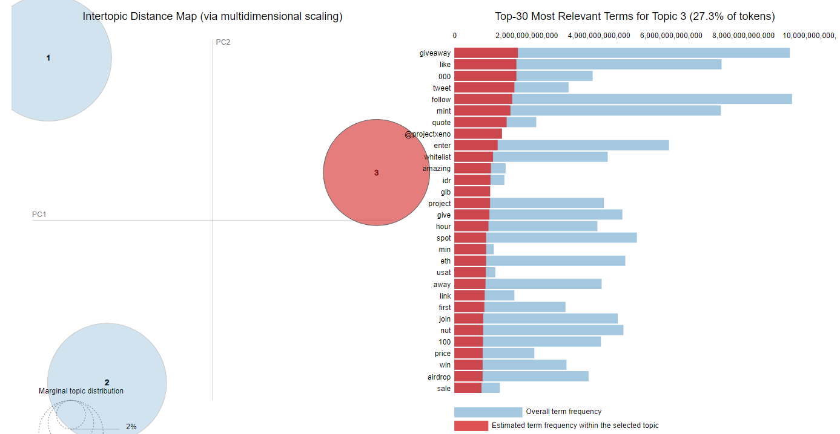
Topic modelling: Community Interaction

Slide 34
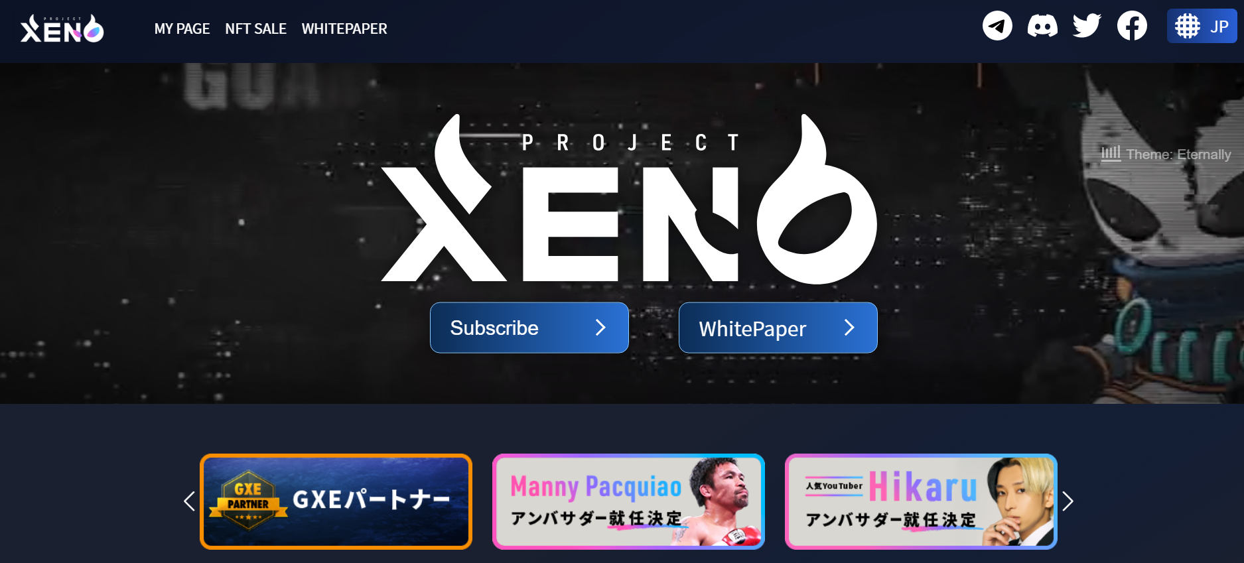

Slide 35
Conclusion
Much greater positive sentiment compared to negative
People trying to make more money since the market was down
There aren’t a lot of influential users tweeting about NFT’s, but there still are some very influential users
Key words such as giveaways, free, and prizes are very common
Notes:
Lots of accounts with very little information given and also created recently in 2022
Roughly 58% of all accounts have less than 100 followers

Slide 36
Limitations and future research
Limitations:
Tweets only from the summer of 2022
Tweets only collected in real-time
6.64 mil tweets is minimal for the total amount of tweets over that summer
Future Research:
Possibility for model building comparing the sentiment to the prices of different NFT projects and/or cryptocurrencies
Analysis on these same tweets now that they have been exposed to Twitter for months
Verified Accounts Analysis

Slide 37

THANKS!
Any questions?

